Slide 1

Feature-Based Used Car Price Predictor Using Linear Regression and Support Vector Machines
By Parker Smith

Slide 2
Outline
Introduction and Motivation: What is the problem and why am I solving it?
Description and Details: A general description of the problem, the solution, and the results.
Extensive Results: A display of the results from this project including
The performed tests
How I gathered data
My key results
Conclusions and Future Work: What do these results show and how can this project be extended in the future?

Slide 3
My Motivation
Currently, the pricing of used cars is unpredictable and expensive. Sellers want the most amount of money for their car, while buyers want to avoid overpaying for a car.
This leads to an interesting standstill for both buyers and sellers where they are undecided as to the proper price for a used car.
By creating an accurate regression model for the price of a used car based on its features, both buyers and sellers can easily determine a fair price for any given used car.

Slide 4
My Motivation (cont.)
This problem to evaluate the price of a used car based on its features may seem simple at first, however it is not.
Interestingly, although there is a linear relationship between a car’s age (or milage) and its price, there is a heavy variation between all the datapoints.
This leads to the conclusion that other non-linear factors are at play, which must be discovered through different means.

Slide 5
Project Description
The baseline for this project is CS 229 Project Report: Predicting Used Car Prices by Kshitij Kumbar, Pranav Gadre, and Varun Naya. (Link to PDF)
The dataset is from Kaggle and contains 1.2 Million used car listings obtained from TrueCar.com. (Link to Dataset)
The overall problem that both the baseline project and I wish to solve is to find an accurate way to predict used car prices.
Essentially, the baseline project stripped the data of all factors except the car’s age, milage, make, model, and price.

Slide 6
My Implementation
For my implementation, I intend to keep more of the factors from the raw data that the baseline project stripped away.
In doing this, there will be more flexibility in the models I generate so they can accurately fit the training and testing data.
Through my implementation, I will create three Linear Regression models (singular, multiple, and polynomial), a Support Vector Machine, and an Artificial Neural Network. After testing, a winning model will be decided: first based on accuracy, then on the time it takes for the model to reach that accuracy.

Slide 7
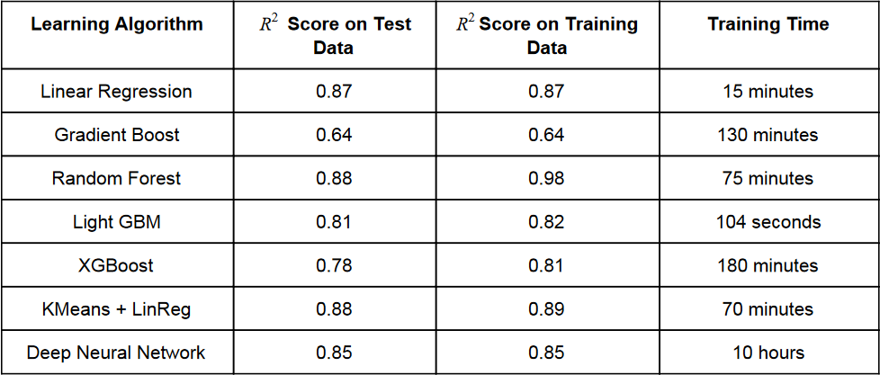









Baseline Results

Slide 8



Interpreting the Results
As is highlighted, Linear Regression has one of the highest R^2 scores with the lowest training time.
This showcases that even when many of the factors from the raw data are ignored, the model will predict an accurate result 87% of the time.
With my implementation, this accuracy can be improved even more.

Slide 9
Future Work
In the future, these models could easily be improved with a greater amount of input data with more features within that data. Examples include quality of the vehicle, the number of doors, how many the car seats, and the size of the engine. More features will always allow for the model to pinpoint a closer price estimate to a given input.
In addition to more data, further tweaking of hyperparameters on an ANN will improve efficiency, although at the cost of training time.

Slide 10
Conclusion
In conclusion, this project will, with varying degrees of efficiency, determine the price of a used car based solely on a few input features.
Due to the linearity of the year-to-price and the milage-to-price data, a Linear Regression model has the quickest training time and turns out to be one of the most accurate models.
Finally, as always, more work can be done to further improve efficiency. However, that would come at the time cost of gathering more data and creating a larger, more complex model.

